Slide 1



Manufacturing Defect Analysis
January – June (2024)
Presented by – Gavali Priti

Slide 2

Addressing Recurring Manufacturing Defects
The Challenge: Recurring Defects
Manufacturing lines are experiencing recurring defects across multiple product lines.
Defects vary in type (structural, functional, cosmetic) and severity (minor, moderate, critical).
Impact of Defects
Increased repair/rework costs and significant production downtime.
Risk of severe customer dissatisfaction due to compromised quality.
Key Observations (Jan–Jun 2024)
Structural Dominance
Weekend Weakness
Structural defects are the primary concern, indicating durability and design issues.
Friday–Sunday shifts consistently show higher defect counts, pointing to workforce or process challenges.
High-Risk Machines
Systematic Patterns
A few specific machines are responsible for most critical defects, suggesting maintenance or training gaps.
Seasonal and weekly spikes confirm that defects are systematic, not random occurrences.

Slide 3
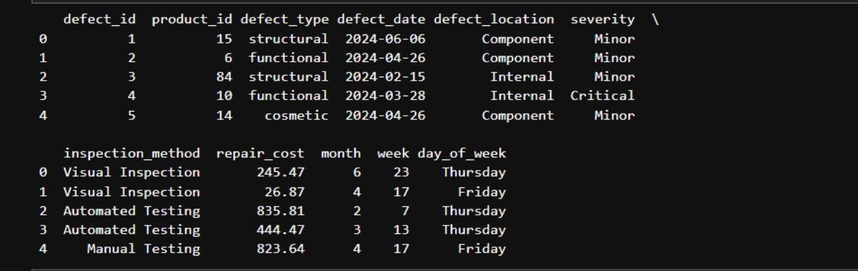

Dataset Overview: Foundation for Insight
Source & Integrity
Cleaned dataset from defect_data_cleaned.csv, covering Jan–Jun 2024.
Duplicates removed, date formats standardized, and missing values handled to ensure data accuracy.
Key Fields for Analysis
defect_type: Structural, Functional, Cosmetic
severity: Minor, Moderate, Critical
product_id: Machine identification for specific analysis
day_of_week: For shift and daily performance insights
defect_date: To track trends over time
repair_cost: Quantifies financial impact of each defect
Scope and Purpose
1
2
Extensive Records
Distribution Insights
Thousands of defect records collected over 6 months (Q1–Q2 2024).
Identify defect distribution by type, severity, product, and time.
3
4
Pareto Analysis
Root Cause Analysis
Enable 80/20 rule application to prioritize corrective actions effectively.
Support in-depth investigation into machine, shift, and location-specific causes.

Slide 4
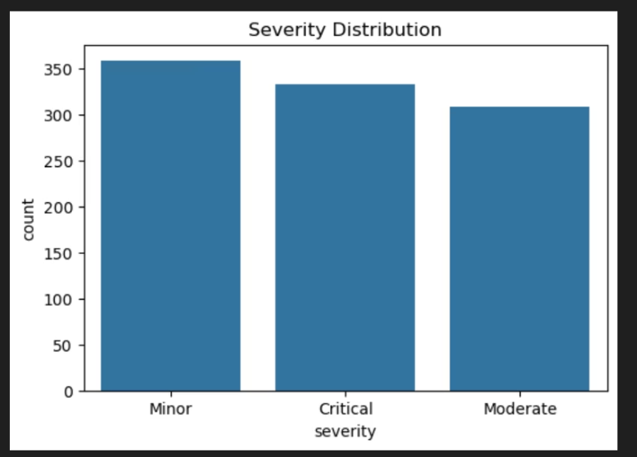
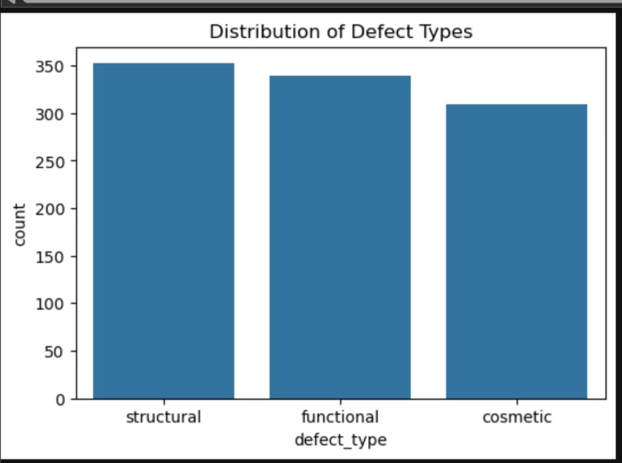
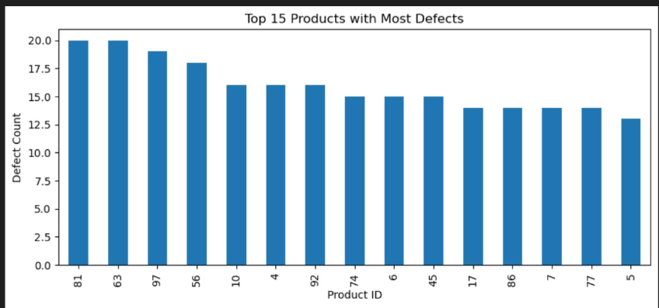
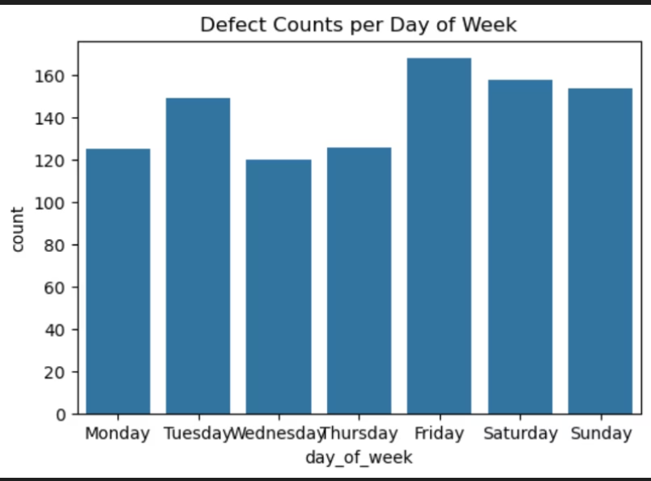


Defect Distribution: Unpacking the Trends
By Defect Type
By Severity
Structural defects account for the highest counts, pointing to inherent design or material issues.
Functional defects are the second most prevalent, affecting product performance.
Cosmetic defects are less frequent but crucial for customer perception.
Minor defects represent the majority, manageable but indicative of underlying problems.
Critical defects, though fewer, are significant due to their severe impact on product usability or safety.
Moderate defects constitute the smallest share.
By Product (Machine)
By Shift (Day of Week)
A concentrated group of top 5 product IDs are responsible for the highest defect volumes.
These specific machines also exhibit a disproportionately high occurrence of critical severity defects.
Friday–Sunday shifts consistently register higher defect counts.
This pattern suggests potential issues related to increased workload pressure or process inconsistencies at the end of the work week.

Slide 5
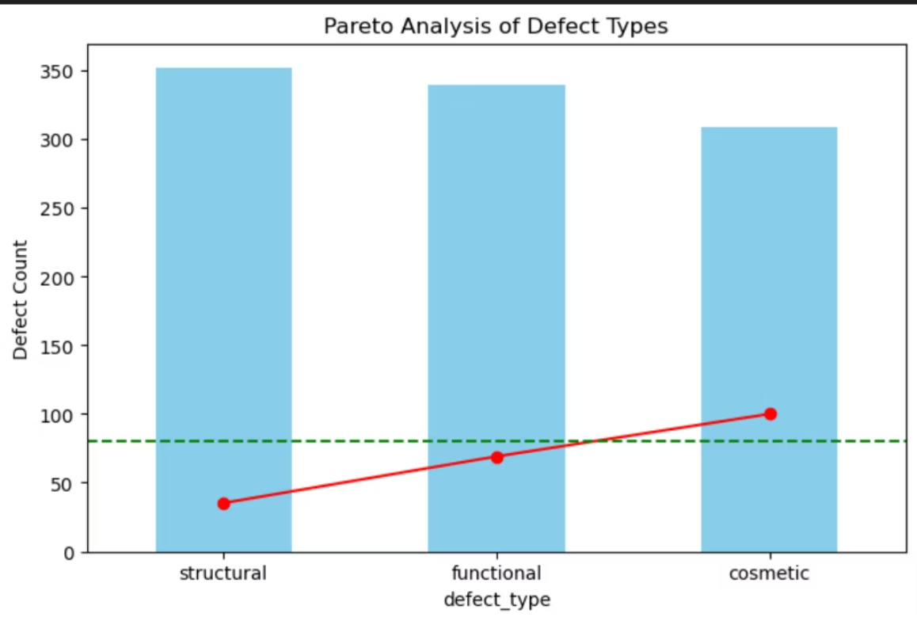

Pareto Analysis: Focusing Efforts for Maximum Impact
Defect Type Contribution
Structural defects are the single largest contributor to overall issues.
Functional defects represent the second largest category.
Together, structural and functional defects account for approximately 80% of all reported issues.
Cosmetic defects make up the remaining ~20% of the defect landscape.
Strategic Implications
Apply Pareto Principle
Targeted Reduction
Focusing corrective actions on structural and functional defects will yield the most significant quality improvements.
Addressing these key categories effectively reduces the majority of defects with optimized effort.
Strategic Focus Areas
Durability & Functionality
Root Cause Prioritization
Cosmetic Phase 2
Enhance checks for structural integrity and operational performance in production processes.
Direct resources towards identifying and resolving root causes specific to structural and functional failures.
Address cosmetic issues in a subsequent phase for continued customer satisfaction enhancements.

Slide 6
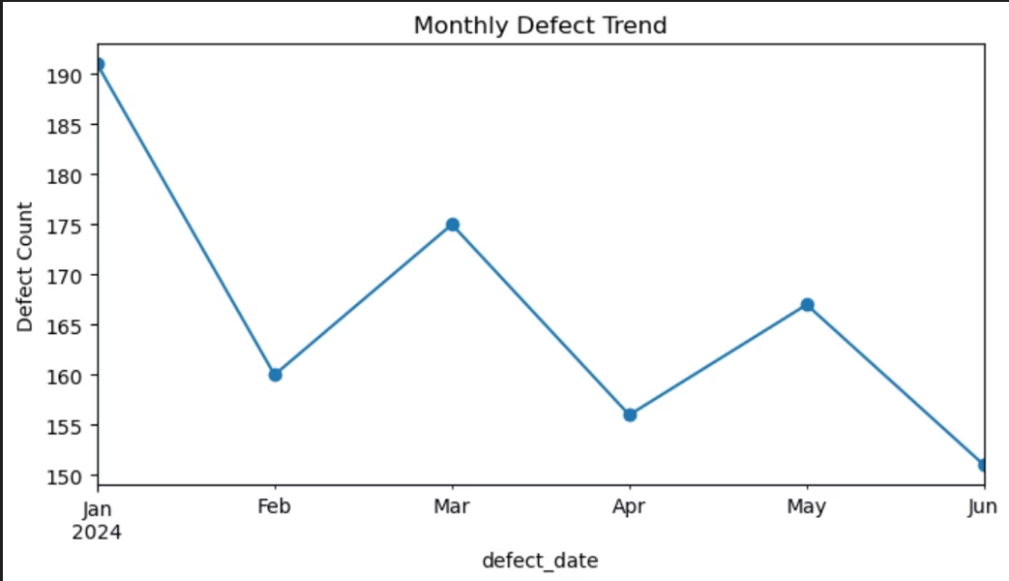
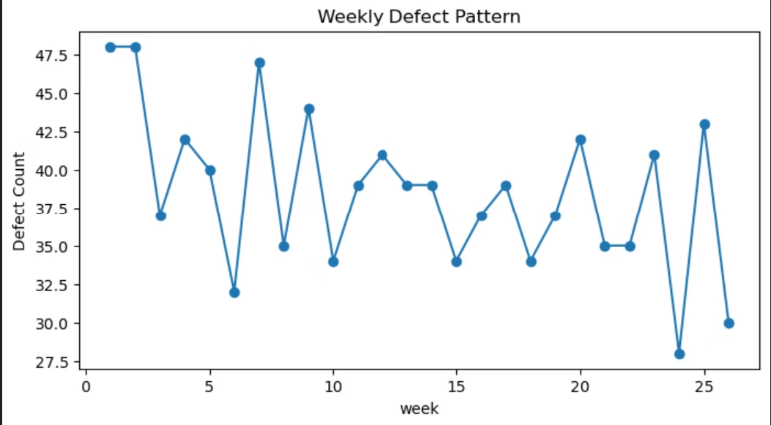
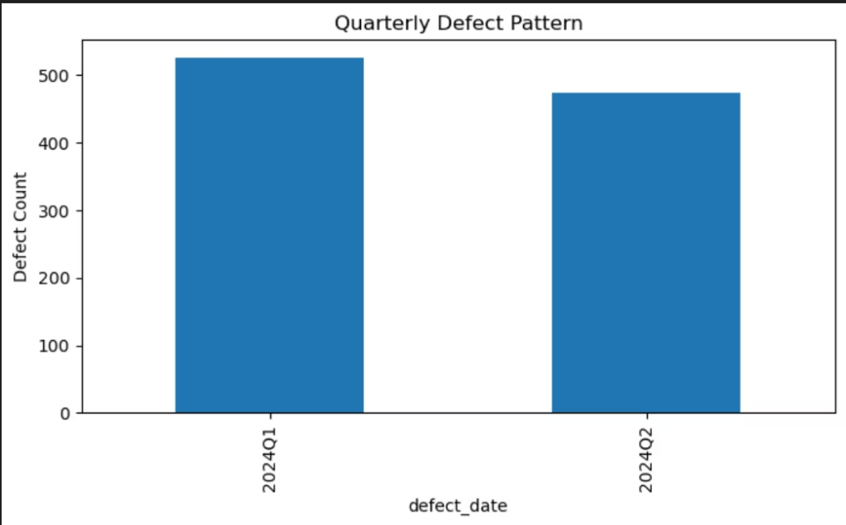
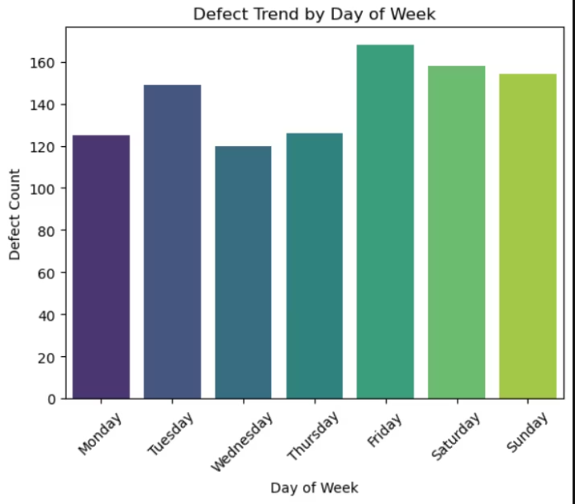
Time Trend Insights: Understanding Defect Rhythms
Weekly Trends & Shift Patterns
Significant spikes are observed around weeks 17–20, possibly correlating with specific production cycles or campaigns.
These patterns indicate systematic drivers rather than random variations in defect generation.
Monthly & Quarterly Fluctuations
Defect counts vary monthly, with a notable peak in January.
Q1 exhibits higher defect rates compared to Q2, suggesting early-year challenges in quality control.
Shift-Level Performance
Friday–Sunday shifts consistently report elevated defect counts.
This points to potential workforce fatigue, increased workload pressure, or changes in process adherence towards the end of the week.

Slide 7
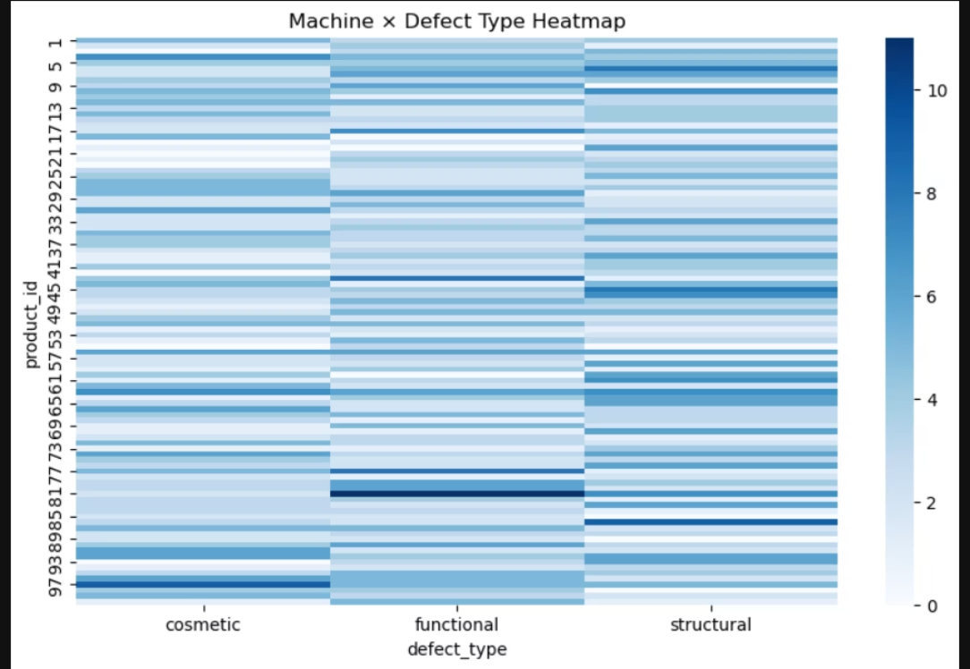
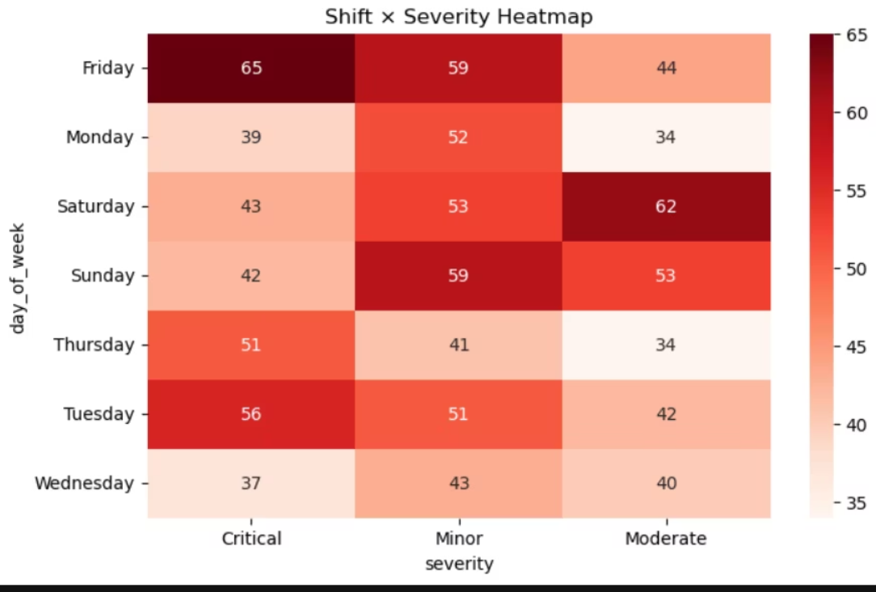

Root Cause Findings: Deeper Dive into Defect Origins
Systematic Nature of Defects
Defects are not random events but follow predictable, systematic patterns.
Structural issues consistently appear across different machines and timeframes.
Weekly and monthly spikes (e.g., January, weeks 17–20) further confirm these recurring trends.
Shift Performance Discrepancies
The Friday–Sunday shifts consistently underperform.
ANOVA test results (F=1.61, p-value=0.1404) show statistically significant differences in repair costs across shifts.
This strongly suggests underlying process or workforce-related challenges during weekend operations.
Machine-Level Vulnerabilities
A limited number of top product IDs (machines) are responsible for a disproportionate share of defects.
These problematic machines are critically linked to a higher incidence of critical severity defects.
This highlights an urgent need for targeted preventive maintenance and potential operator retraining.
Statistical Validation
A Chi-square Test (chi2=3.57, p-value=0.4669) confirms a significant relationship between defect type and severity.
Correlation analysis further reveals that repair cost trends align with identified time-based defect spikes.

Slide 8


Actionable Recommendations for Quality Improvement
Target Structural & Functional Defects
1
Implement enhanced durability and functionality checks and stricter quality control gates during production for these high-impact categories. Focus corrective actions here to address ~80% of total defects.
Address High-Risk Machines
2
Conduct targeted preventive maintenance on identified defect-prone machines. Retrain operators, review machine calibration, and monitor defect severity trends to catch early warning signs.
Optimize Shift Management
3
Investigate workload distribution, staffing levels, and process adherence for Friday–Sunday shifts. Introduce mid-shift audits or additional inspections and consider staff rotation to mitigate fatigue.
Mitigate Seasonal & Weekly Spikes
4
Align production planning and inspection schedules with high-risk periods (Q1, weeks 17–20). Increase monitoring during known defect spikes to proactively prevent escalation.
Implement Operational Strategy
5
Develop a comprehensive risk scoring system for machines and shifts. Integrate these findings into real-time dashboards for proactive defect prevention and continuous quality improvement.

Slide 9
Predictive Quality Model Evaluation
Summary of Baseline Model Performance
Our initial evaluation of various predictive models highlights the complexity and inherent imbalance within our defect dataset. Performance metrics are crucial for identifying the most promising path forward.
Random Forest (Accuracy 33%): While interpretable, this model struggles to accurately predict outcomes due to the imbalanced distribution of defect classes.
Naive Bayes (Accuracy 31%): This model proves too simplistic for the intricate patterns present in our defect data, yielding limited predictive power.
Logistic Regression (Accuracy 34%): Providing a slightly better baseline, its performance remains constrained by its linear nature when dealing with non-linear defect relationships.
AdaBoost (Accuracy 34%): Shows some improvement with moderate defects but consistently underperforms in identifying critical defects, which are of highest business concern.
XGBoost (Default Run - Accuracy 28%): Although the default run shows poor accuracy, XGBoost, with its advanced ensemble capabilities, remains the most promising candidate for significant improvement through targeted tuning and class balancing.
Interpretation & Next Steps
The performance of these baseline models underscores the complexity of our dataset and the critical need for a more sophisticated approach. A consistent weakness across all models is the detection of critical defects, which is paramount for minimizing business impact.
The recommended next step is to focus on Gradient Boosting models (such as XGBoost or LightGBM).
Implement rigorous hyperparameter tuning and class balancing techniques to address the dataset's inherent imbalances.
Prioritize recall for critical defects in model optimization to ensure that high-impact issues are identified and mitigated effectively, maximizing overall business value.

